Slide 1
Solving the sharing paradox - How data sharing can be promoted for the benefit of research integrity
Johannes Breuer
GESIS – Leibniz Institute for the Social Sciences
Data Archive for the Social Sciences

Slide 2
Background
threats to research integrity and trust (with)in science:
fraud
Questionable Research Practices (QRPs):
p-hacking
HARKing
selective reporting/outcome switching
…

Slide 3
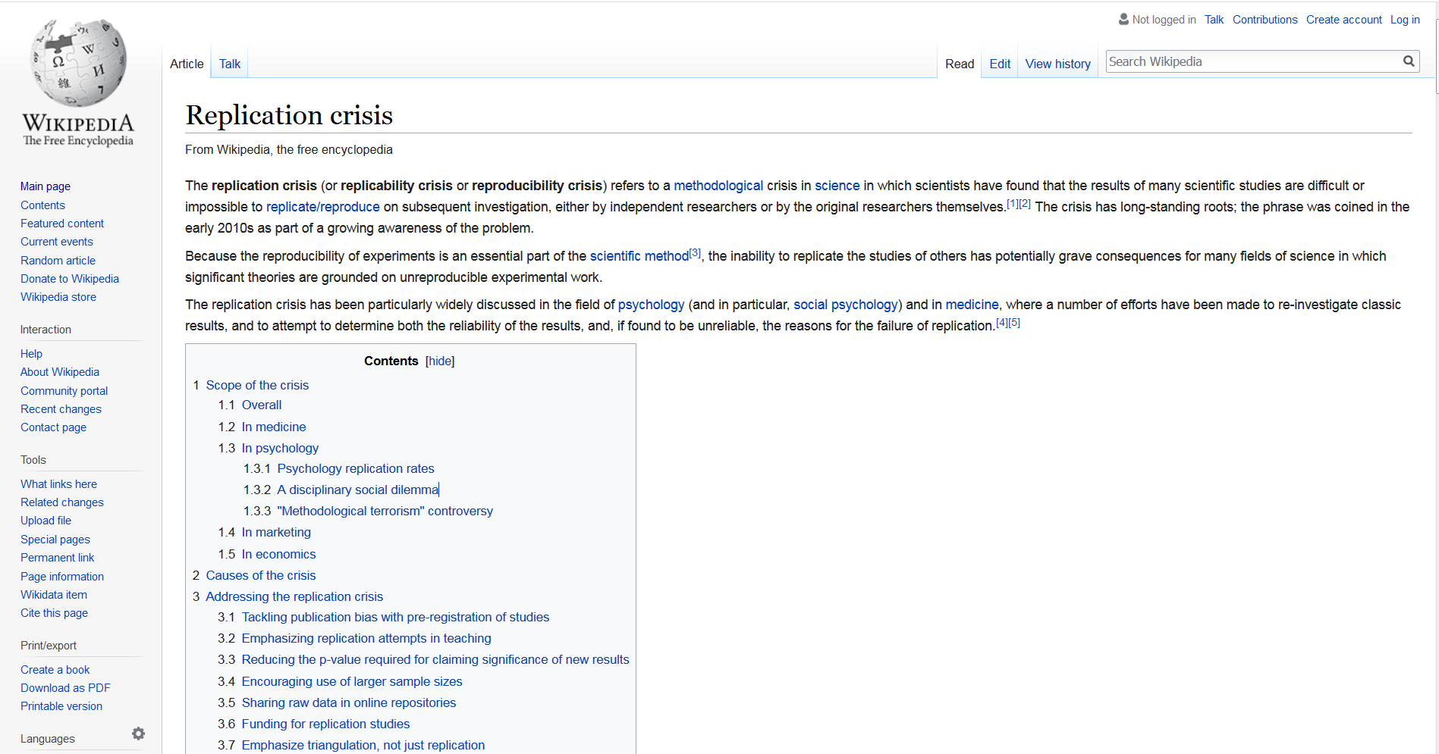
Background
Replication crisis…
… in psychology (Open Science Collaboration, 2015)
… but (potentially) also in other areas, such as,
… economics (Chang & Li, 2015),
… cancer biology (Kaiser, 2017),
... and other fields (Ioannidis, 2005)
Open Science Collaboration (2015). Estimating the reproducibility of psychological science. Science, 349(6251), aac4716. doi:10.1126/science.aac4716
Chang, A. C., & Li, P. (2015). Is Economics Research Replicable? Sixty Published Papers from Thirteen Journals Say ”Usually Not”, Finance and Economics Discussion Series 2015-083. Washington: Board of Governors of the Federal Reserve System. doi:10.17016/FEDS.2015.083.
Kaiser, J. (2017, Jan 18). Rigorous replication effort succeeds for just two of five cancer papers. Science Magazine. doi:10.1126/science.aal0628
Ioannidis, J. P. (2005). Why most published research findings are false. PLoS Medicine, 2(8), e124. doi:10.1371/journal.pmed.0020124

Slide 4
Detection of fraud or (over)use of QRP
Whistleblowers
Self-incrimination
Data detectives
e.g., “Detectives James Heathers and Nick Brown and the curious case of the long-haired voluptuous red-shirted high-heeled woman and the dead plant”
https://steamtraen.blogspot.de/2017/11/some-problems-in-field-study-of-sexual.html
https://medium.com/@jamesheathers/life-in-the-tinderbox-6b2e9760f3aa
https://steamtraen.blogspot.de/2017/12/more-problematic-sexual-attraction.html
https://medium.com/@jamesheathers/long-hair-dont-care-5eeba266ec52
or “Pizzagate” (for a detailed overview see http://www.timvanderzee.com/the-wansink-dossier-an-overview/)

Slide 5
Openness & Transparency
Open Science as a means to…
… increase/restore trust in science
… increase research integrity
… facilitate verifiability, self-correction, & cumulative insights
… boost the efficiency of scientific discovery
… render data detectives unnecessary (by giving everybody the chance to fully understand/check/work with existing research data)
Sharing of data, materials, etc. is an important part of Open Science

Slide 6
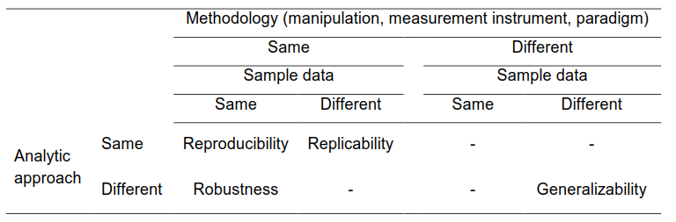
Data sharing for reproducible and robust results
From: LeBel, E. P., Vanpaemel, W., McCarthy, R., & Earp, B., & Elson, M. (2017). A Unified
Framework to Quantify the Trustworthiness of Empirical Research. Manuscript under
review @ Advances in Methods and Practices in Psychological Science. Retrieved from
https://osf.io/preprints/psyarxiv/uwmr8

Slide 7
The sharing paradox
Privacy paradox in research on digital/social media: Many/most people say/agree that privacy is important, but few actively engage in privacy-protecting behavior (Norber, Horne, & Horne, 2007; for a recent overview, see Kokolakis, 2017)
→ Discrepancies between attitude and behavior
Sharing paradox in science: Many/most people say/agree that data sharing is important, but few actively engage in it
Norberg, P. A., Horne, D. R., & Horne, D. A. (2007). The privacy paradox: Personal information disclosure intentions versus behaviors. Journal of Consumer Affairs, 41(1), 100-126. doi 10.1111/j.1745-6606.2006.00070.x
Kokolakis, S. (2017). Privacy attitudes and privacy behaviour: A review of current research on the privacy paradox phenomenon. Computers & Security, 64, 122-134. doi:10.1016/j.cose.2015.07.002

Slide 8
Why do researchers not share their data?
Nelson (2009): “Most researchers agree that open access to data is the scientific ideal, so what is stopping it happening?”
considerable differences between fields (Borgman, 2012)
(Potential) Reasons for not sharing data (see, e.g., Borgman, 2012; Dehnhard et al., 2013; Vanpaemel et al., 2015):
fear of “being scooped” (other researchers publish earlier)
fear of reputational damage (e.g., errors spotted by others)
extra effort and expertise needed for data management & documentation
lack of incentives
privacy/data protection concerns
Nelson, B. (2009). Empty Archives. Nature, 461, 160-163. doi:10.1038/461160a
Borgman, C. L. (2012). The conundrum of sharing research data. Journal of the Association for Information Science and Technology, 63(6), 1059-1078. doi:10.1002/asi.22634
Dehnhard, I., Weichselgartner, E., & Krampen, G. (2013). Researcher's willingness to submit data for data sharing: A case study on a data archive for psychology. Data Science Journal, 12, 172-180. doi:10.2481/dsj.12-037
Vanpaemel, W., Vermorgen, M., Deriemaecker, L., & Storms, G. (2015). Are we wasting a good crisis? The availability of psychological research data after the storm. Collabra, 1(1), Art.3, 1-5. doi:10.1525/collabra.13

Slide 9
Science as a system
data sharing is beneficial for science
openness & transparency as scientific ideals
cooperation vs. competition
openness & transparency facilitate cooperation
competition typically limits openness & transparency
examples: rise and fall of the Pirate party (in Europe) or efforts at crowd-managing sports clubs

Slide 10
Scientists are human
scientists cooperate and compete (often even with the same people)
scientists have limited time and need to effectively allocate their resources
Borgman (2012, p. 1073): “Data are more likely to be shared when the policies beneﬁt those who produce the data. This is a simple statement of self-interest. Researchers collaborate, but they also compete for grants, for jobs, for publication venues, and for students. They must choose carefully where to spend their time and resources. Time and money spent on documenting data for use by others are resources not spent in data collection, analysis, equipment, publication fees, conference travel, writing papers and proposals, or other research necessities.”

Slide 11
How can data sharing be promoted?
Change the incentive structures
Reduce time and effort needed for data sharing
Educate scientists (and students)
bottom-up initiatives, e.g.:
Peer Reviewers Openness (PRO) Initiative (https://opennessinitiative.org/)
Network of Open Science Initiatives (NOSI) at psychology departments in Germany (https://osf.io/x3s5c/wiki/home/)
top-down measures, e.g.:
(inter-)national policy/laws
funder requirements
journal requirements

Slide 12
Incentive structures
need to align benefits for science as a system and researchers as individuals
(further) investigate and make researchers aware of the practical benefits of data sharing
protection against data loss
documenting & sharing data facilitates cooperation and makes it easier to keep track of what has been done
data sharing can increase # of citations (Piwowar & Vision, 2013)
develop (and adhere to) standards for data citation and give credit to (i.e., cite) resources (Park & Wolfram, 2017)
take data sharing practices into account when evaluating researchers (e.g., in funding, hiring or tenure decisions)
(further) evaluate and implement symbolic incentive systems (e.g., badges)
almost 10-fold increase in data sharing after badges were introduced at the journal Psychological Science (Kidwell et al., 2016)
Piwowar, H. A., & Vision, T. J. (2013). Data reuse and the open data citation advantage. Peer J, 1, e175. doi:10.7717/peerj.175
Park, H., & Wolfram, D. (2017). An examination of research data sharing and re-use: implications for data citation practice. Scientometrics, 111(1), 443-461. doi:10.1007/s11192-017-2240-2
Kidwell, M. C., Lazarević, L. B., Baranski, E., Hardwicke, T. E., Piechowski, S., Falkenberg, L.-S., … Nosek, B. A. (2016). Badges to Acknowledge Open Practices: A Simple, Low- Cost, Effective Method for Increasing Transparency. PLoS Biology, 14(5), e1002456. doi: 10.1371/journal.pbio.1002456

Slide 13
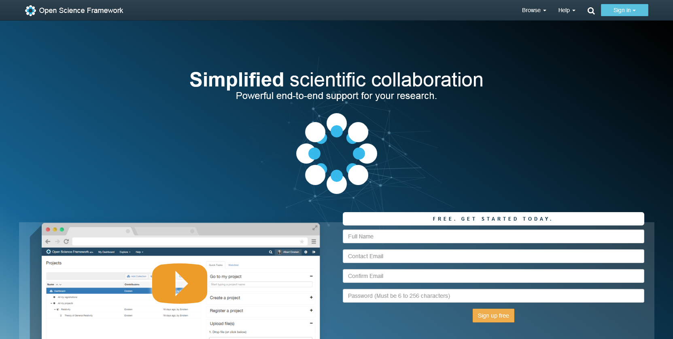
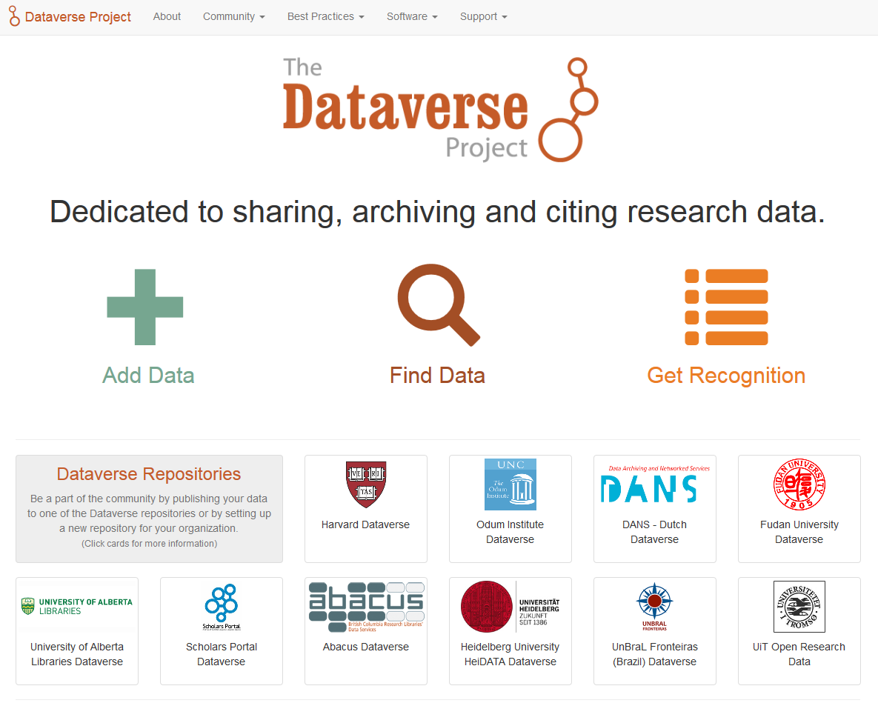
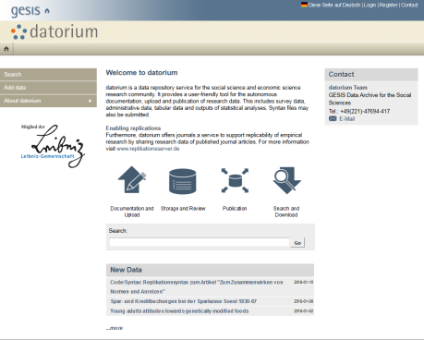
Time and effort needed
use and development of tools for data management/sharing
for interesting insights into the development of research tools and workflows, see the Innovations in Scholarly Communication project: https://101innovations.wordpress.com/
repositories for research data
some recommendations for repositories: https://www.nature.com/sdata/policies/repositories
comprehensive database: https://www.re3data.org/
data management tools, e.g.:
ZPID DataWiz (https://datawiz.zpid.de/)

Slide 14
Education
Educating researchers
workshops on data management (and open science)
for social scientists, e.g.:
GESIS (Germany): https://www.gesis.org/en/services/events/gesis-training/
Consortium of European Social Science Data Archives (CESSDA, Europe): https://www.cessda.eu/Research-Infrastructure/Training
Berkeley Initiative for Transparency in the Social Sciences (USA): https://www.bitss.org/event-types/workshop/
tutorials, guidelines, & training materials
CESSDA materials on research data management: https://www.cessda.eu/Research-Infrastructure/Training/Research-Data-Management
Schönbrodt, F., Gollwitzer, M., & Abele-Brehm. A. (2016). Data management in psychological science: Specification of the DFG guidelines. Retrieved from https://www.dgps.de/fileadmin/documents/Empfehlungen/Data_Management_eng.pdf
Klein, O., Hardwicke, T., Aust, F., Breuer, J., Danielsson, H., Hofelich Mohr, A., Ijzerman, H., Nilsonne, G., Vanpaemel, W., & Frank, M. C. (in prep.). A practical guide for transparency in psychological science.
Educating students
Nature (2009, p. 145): “data management should be woven into every course in science, as one of the foundations of knowledge”
King (2011, p. 720): “when we teach we should explain that data sharing and replication is an integral part of the scientific process. Students need to understand that one of the biggest contributions they or anyone is likely to be able to make is through data sharing”
Nature editors (2009). Data’s shameful neglect. Nature, 461(7261), 145. doi:10.1038/461145a
King, G. (2011). Ensuring the data-rich future of the social sciences. Science, 331(6018), 719-721. doi:10.1126/science.1197872

Slide 15
Summary
openness & transparency can increase research integrity
sharing of data (+ materials, etc.) is an integral part of Open Science
most scientists endorse data sharing, but many do not (actively) engage in it → the sharing paradox
three strategies to promote data sharing:
Change incentive structures
Reduce time and effort needed
Educate researchers & students
general advice:
incremental change is better than no change
a combination of bottom-up and top-down initiatives should work best
rewards generally work better than punishment/threats

